Slide 1
Capstone Project
Battle of Neighborhoods-Toronto and New York

Slide 2
Introduction and Business problem
Company XYZ, headquartered in India is planning to set up a conference in North America. It has offices in both Toronto and New York.
Janice, the senior manager wants to compare downtown Toronto and Manhattan as the two cities for the Conference.
Explore neighborhoods in the two cities
Explore the demographics of the two cities such as population, average income and density of each neighborhood.

Slide 3
Data -1
Toronto data that contains different borough, neighborhoods and their postal codes
https://en.wikipedia.org/wiki/List_of_postal_codes_of_Canada:_M
Coordinates of the Toronto neighborhoods
http://cocl.us/Geospatial_data/Geospatial_Coordinates.csv
New York data containing different boroughs, neighborhoods and their coordinates
The coordinates (latitude, longitude) of the neighborhoods of Downtown Toronto and Manhattan using geolocator

Slide 4
Data-2
From Foursquare API, we will need the following data:
-Nearby venue names with their latitudes and longitudes
-Top 5 most common venues for each neighborhood
-Top 10 most common venues for each neighborhood
Average Income, Population and Density of New York
Wikipedia (Demographics of New York City)
Average Income, Population and Density of Toronto
Wikipedia (Demographics of Toronto neighbourhoods)

Slide 5
Methodology
Extract Toronto and New York borough and neighborhood data
Get the latitudes and longitudes of the neighborhoods
Compare Downtown Toronto and Manhattan
-Coordinates
-use Foursquare API, to get nearby venues for each city
-Analyze each neighborhood to find the most common venues
-For each neighborhood, find the 10 most common venues
-Run k means clustering for each neighborhood by setting k=5 clusters
-Map 10 most common venues of each neighborhood with their clusters

Slide 6
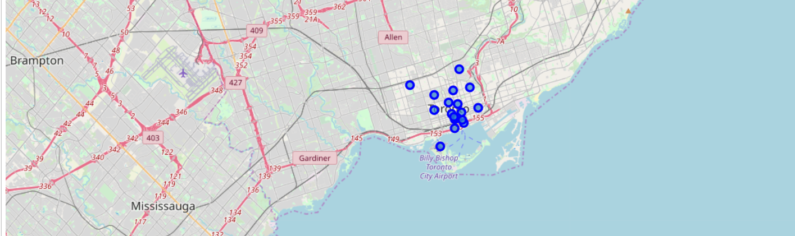
Downtown Toronto neighborhoods

Slide 7
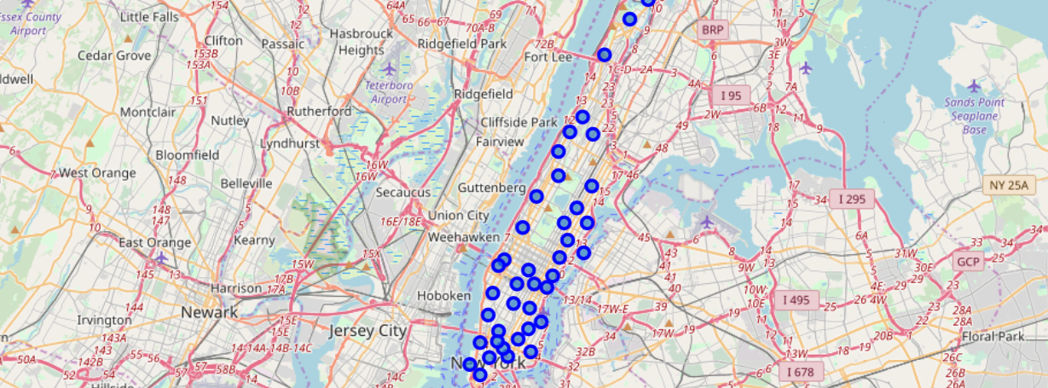
Manhattan neighborhoods

Slide 8
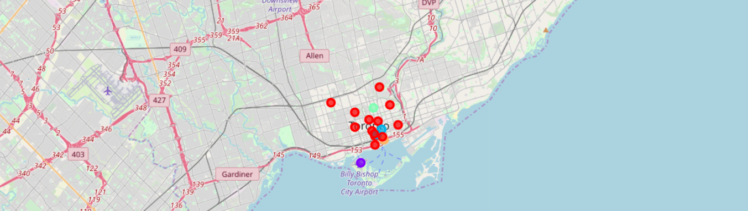
Downtown Toronto neighborhood cluster

Slide 9
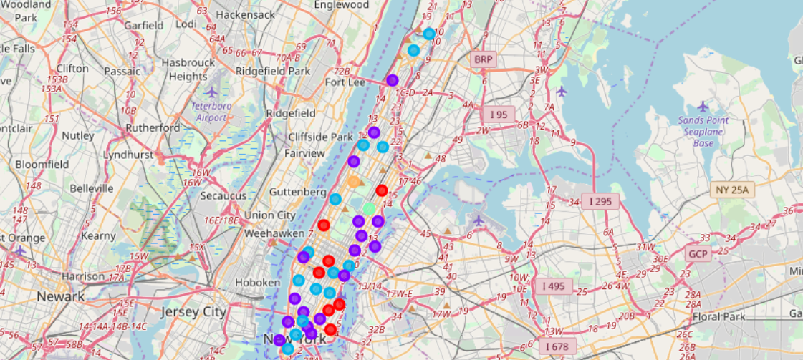
Manhattan neighborhood cluster

Slide 10
Methodology
Extract Average Income, Population and Density data of the two cities from Wikipedia.
Compare the two cities for each of the categories using bar charts.

Slide 11
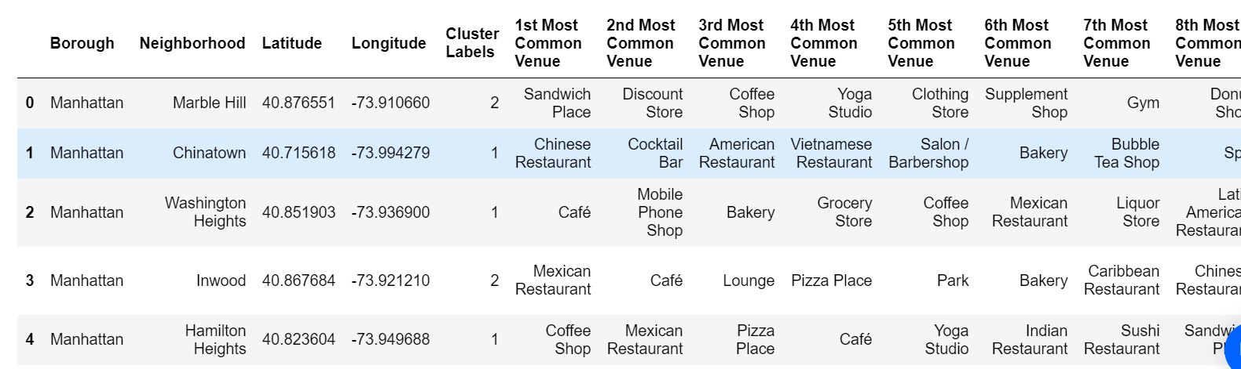
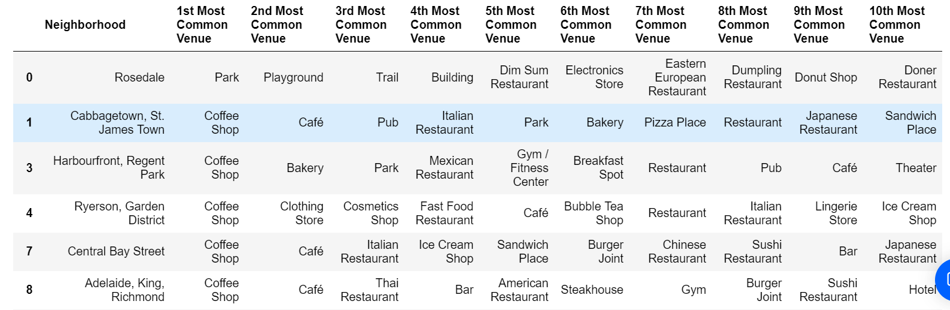
Results
Downtown Toronto and Manhattan are similar in nearby venue categories, with few differences
Manhattan | Downtown Toronto
Bigger city, has more neighborhoods | Smaller city, has lesser neighborhoods
Restaurants are the most common venues | Coffee shops are the most common venues
Financial district | Financial district

Slide 12
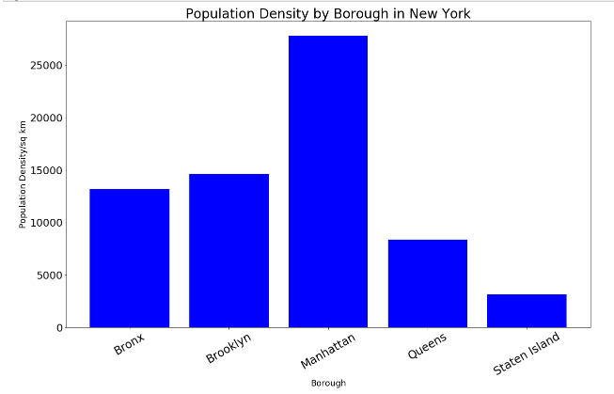
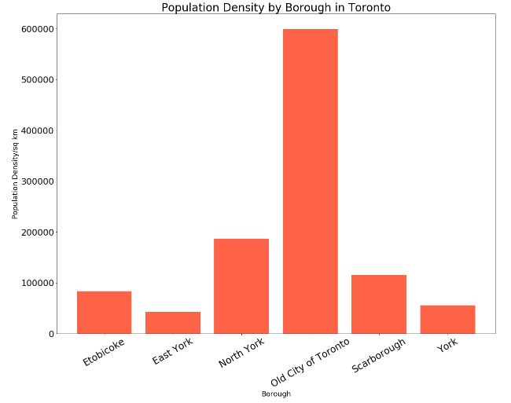
Population Density

Slide 13
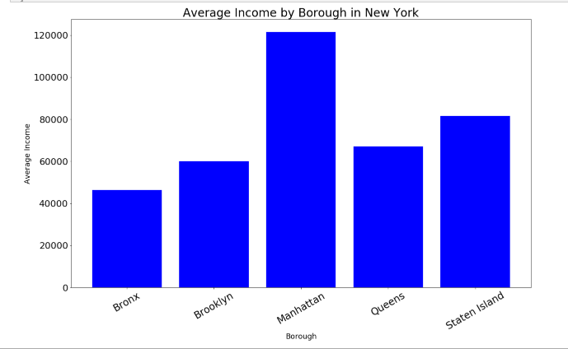
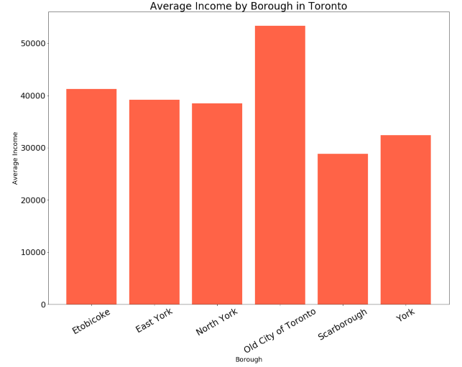
Average Income

Slide 14
Discussion/Recommendation
Analysis can be improved by considering the following:
Hotel prices for the conference in both Manhattan and Downtown Toronto.
Taking into account the number of conference attendees in both cities to reduce travel time for the employees.
The distance between the chosen city office and the hotel for the conference.
The data accuracy of venues depends on Four square API.

